Slide 1
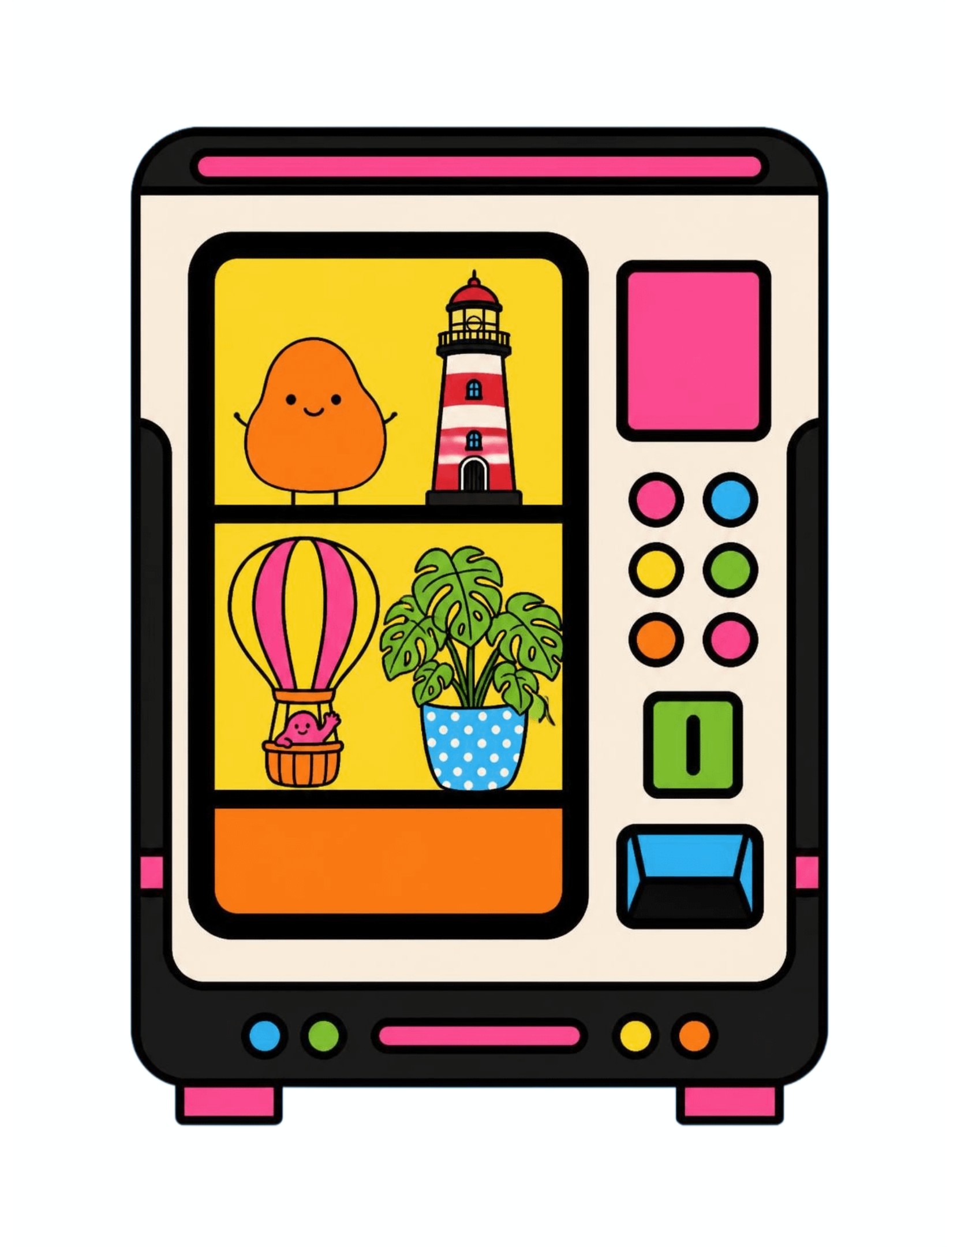

CAPSTONE PROJECT
VENDING MACHINE CONTROLLER STIMULATOR
Team - 2620030470 (K Sujji Reddy)
2620030297 (Sahithi Ayyagari)

Slide 2

01 · WHY THIS PROJECT
What the simulator should handle
ABSTRACT
Show products, codes, prices and availability.
Let a user choose a product and enter money.
Check invalid selections and insufficient funds.
Complete a valid purchase and report any change.
WHAT WE WANT TO ACHIEVE
Show how a simple interactive program can mimic a vending machine without needing hardware.
Use the project to learn and apply core Java programming ideas in a concrete, user-facing system.
The goal is a clear, interactive learning model—not a claim to reproduce every physical vending-machine feature.

Slide 3
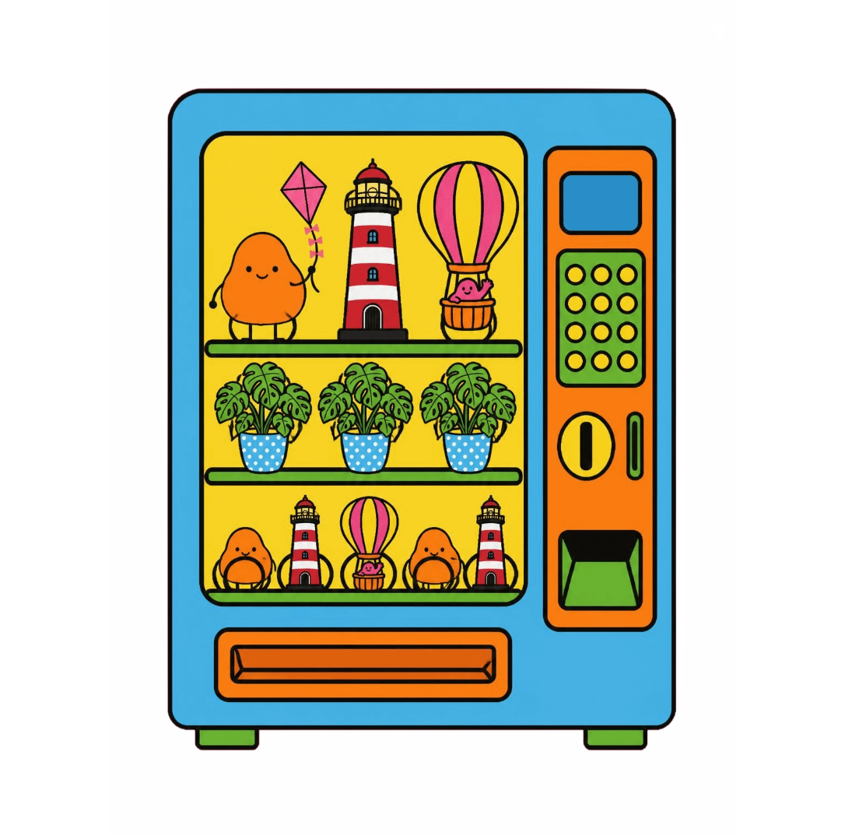
02 · SYSTEM VIEW
Core components
THE WORKING OF OUR PLAN
Product data
Input layer
A menu-driven controller connects product data, user input and transaction rules. Each choice moves through a predictable loop: display, validate, respond and update.
Names, codes, prices and stock levels are kept together so the controller can find and update one product consistently.
Menu choices and payment tokens from the user are read, parsed and passed to the controller for checking.
Controller rules
Output
Validation, payment checks and inventory updates keep invalid choices from reaching the purchase step.
Purchase status, a clear reason for failure and the calculated change explain the result to the user.

Slide 4
03 · USER JOURNEY
ONE TRANSACTION, STEP BY STEP
The simulator turns a vending-machine purchase into a visible sequence of decisions, making it easy to trace both success and failure paths.
1
2
3
4
5
6
Show products, codes, prices and stock.
Choose a valid product code.
Enter the payment amount.
Check code, stock and funds.
Confirm purchase and return change.
Reduce inventory for the next user.

Slide 5
04 · JAVA TOOLKIT
JAVA CONCEPTS IN THE SIMULATOR
Control flow
Arrays
if/else handles validity and payment decisions. Loops keep the menu active until the user exits or completes a transaction.
Fixed-length, same-type containers store parallel product details; one index links a name, code, price and stock value.
Each concept supports a specific part of the interaction, turning familiar Java syntax into visible machine behavior.
Scanner
Methods
Reads formatted user input and parses typed tokens such as codes and amounts, while the program prompts for the next value.
Separate tasks into reusable units—display, lookup, validate, purchase and report—so each method has one clear responsibility.

Slide 6
05 · CONTROLLER LOGIC
FROM INPUT TO OUTCOME
The controller evaluates one state at a time, making the result explainable to the user.
READY
CHECK
RESULT
Show products and wait for a selection.
Find the code, availability and required price.
Complete the sale, reject it with a reason, or return change.
After a successful purchase, stock is reduced and the next interaction starts from the updated data.

Slide 7
06 · QUALITY + NEXT STEPS
Test cases to cover
TESTING AND FUTURE ENHANCEMENTS
Valid product and sufficient money
Invalid product code
Out-of-stock product
Insufficient money and change handling
Exit or repeated menu interaction
Test the decision paths before adding complexity.

Slide 8
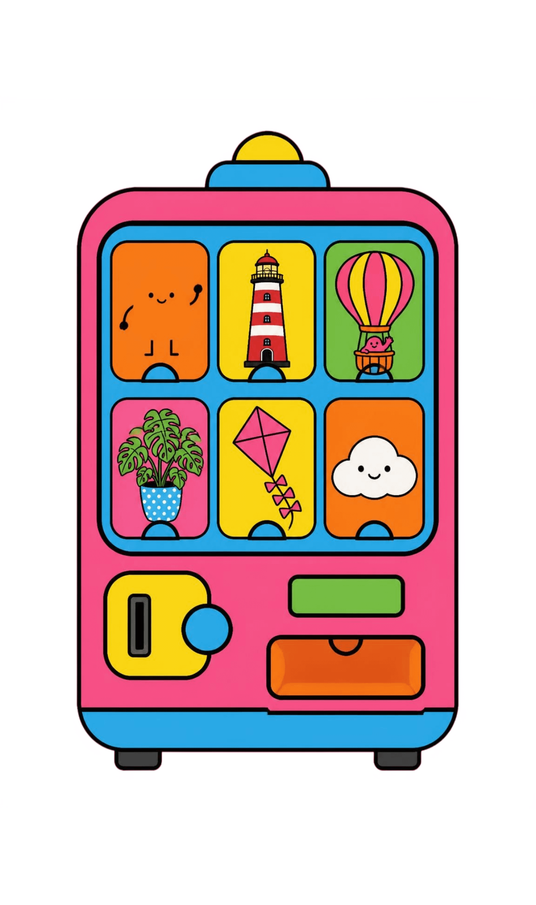
THANK YOU

